Slide 1

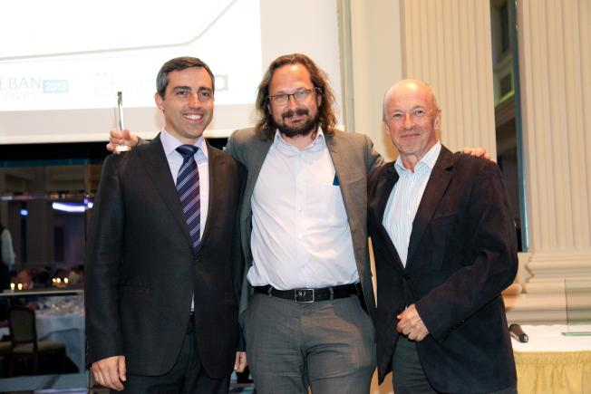
Awarded European Angel of the Year 2013
by EBAN
EBAN President Paulo Andrez, Stojanovic and AAIA President Hansi Hansmann.
Credit: Austrian Angel Investors Association (AAIA)/APA-Fotoservice/Rastegar
3 positive exits in a week between June 27th and July 2nd, 2012
And a Great Joint Venture on March 6th, 2013
*

Slide 2
1st Exit on 27-June-2012
Mooreland Partners advises ProwebCE on recapitalization led by Edmond de Rothschild Investment Partners and Iris Capital
Mooreland Partners acted as financial advisor to the management and shareholders of ProwebCE S.A (ALPRW.PA) in the €36 million recapitalization of the company led by Edmond de Rothschild Investment Partners and Iris Capital, with additional financing provided by the corporate alternative investment fund of Edenred S.A (EDEN.PA).
ProwebCE is the leading provider of enterprise software and e-commerce solutions for the "Comités d'Entreprise" market in France. The Company's integrated SaaS package enables the efficient administration of employee subsidy programs. ProwebCE also provides an e-commerce platform linked to its software suite that allows employees to seamlessly manage and spend their subsidies online. ProwebCE was founded in 1998 and is headquartered in Levallois-Perret, France.
Exit after 6,5 years
Growing from 1 MEUROS to 6O MEUROS of Revenues
and from 12 to 250 Employees
Market Leader and to some degree tech play

Slide 3
2nd Exit: 28-June-2012
SCCP Payment Services consolidates hold on secure and authenticated mobile transaction space with large majority stake holding in 4G SECURE SAS (Europe)
Leading secured payment technologies firm, SCCP Payment Services Holdings, announced its strategic entry into the secured authentication space with a large majority stake purchase agreement with 4G SECURE SAS (Europe), a company specialised in the development of a full patented authentication platform and mobile phone applications. The acquisition of Europe’s frontrunner in authentication and mobile security solutions is SCCP Payment Services Holdings’ latest step in its expansion into the mobile commerce marketplace.
“As part of our growth strategy, we have sought to expand our hold on the mobile payment space through accessing new technologies that complement what we already have in the form of Swiff,” said Jerome Cle, Founder and CEO of SCCP Payment Services Holdings. “4G SECURE is a natural fit because its patented and proven authentication technologies align with our payment solutions.
Exit after 14 months
Tech Play - End result of a very exiting Euro-Asian Mobile Payment Player

Slide 4
3rd Exit on 02-July-2012
GP Bullhound advises Swedish Payson on its sale to Svea Ekonomi acting as the exclusive financial advisor to Payson on its sale to Svea Ekonomi completed on 20 June 2012. GP Bullhound worked closely with the company to articulate the key value drivers for the business and emphasize Payson’s unique market position.
Launched in 2004, Payson is one of Sweden’s leading web payment solution providers with over 5,000 merchants and close to 2 million wallets. Payson offer card and direct bank payments as well as escrow and invoice services. Payson will together with Svea Ekonomi’s existing web payment solution have a yearly turnover of around SEK100m from day one. The transaction is subject to approval from the Swedish Financial Supervisory Authority.
Oskar Bjursten, CEO of Payson, commented: “GP Bullhound has been instrumental in finding the right buyer and home for Payson where the strategic industry fit is perfect. Their experience and determination to assist in every step of the transaction process has been very helpful.“…………..
Exit after 7 years
Mainly Market Leader play and to some degree a Tech Play

Slide 5
Joint Venture on 06-March-2013
”The NASDAQ OMX Group, Inc. (Nasdaq:NDAQ) and SharesPost, Inc. announced today a joint venture that will establish the preeminent marketplace for private growth companies. The venture combines NASDAQ OMX's market and operating expertise as well as resources with SharesPost's leading web-based platform. The NASDAQ Private Market (NPM) will provide improved access to liquidity for early investors, founders and employees while enabling the efficient buying and selling of private company shares.
While NASDAQ will retain a majority stake in the venture, specific terms of the joint venture were not disclosed. "The support of entrepreneurs is a fundamental element of our DNA at NASDAQ OMX," said Bruce Aust, EVP of NASDAQ OMX. "The NASDAQ Private Market will provide private companies additional flexibility as they plan for their future and, at the same time, bring the investment community unique opportunities. By combining our resources, expertise and reach with SharesPost's established technology, we will bring scale, efficiency and transparency to this marketplace.« An increasing number of companies are choosing to remain private longer, which requires an efficient means to access liquidity for employees and investors. NPM will offer a complete, end to-end solution that will enable a private company to control the marketplace for its shares. Transactions on NPM will meet NASDAQ OMX's industry-leading standards for security, compliance and client support.
NASDAQ OMX AND SHARESPOST TO FORM PRIVATE MARKET
Intends to Enhance the
Efficiency and Control of the Market for Private Shares

Slide 6
CHALLENGE
EXECUTIVE SUMMARY
Exits after between 14 months and 7 years
2 companies sold, 1 company got bought, 1 company JV
In two deals advisors in two no advisors
3 out of 4 clear market leaders
All 4 payment related/financial services = where I made my entrepreneur exit
Exits between 86% annual return and 10 times money invested
Countries where companies where located
    France 2
    Sweden 1
    US 1
Buyers/JV partners:
    France but with Global Presence
    Asia
    Sweden but with Pan – European Presence
    Global with US headquarters

Slide 7
WHAT DID I LEARN
LUCK, LUCK and LUCK is KEY
LUCK tends to be a result of hard work
The bet on the right entrepreneur is key
Networking is key to identify buyers
Advisors like to come when buyer(s) is (are) already identified and first discussions have taken place
If there is an offer on the table – Do not hesitate take the cash
INVESTING IS A GAMBLE LIKE POKER IS – A SKILL BASED GAMBLE
AND IT’S NOT A ZERO WIN GAME
MORE INVESTORS WILL WIN OVER TIME THAN THOSE WHO LOSE

